Slide 1
Stacks and Queues

Slide 2
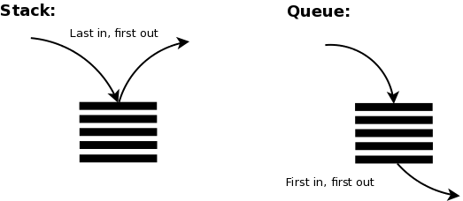
Stacks and Queues

Slide 3
Stack Operations

Slide 4
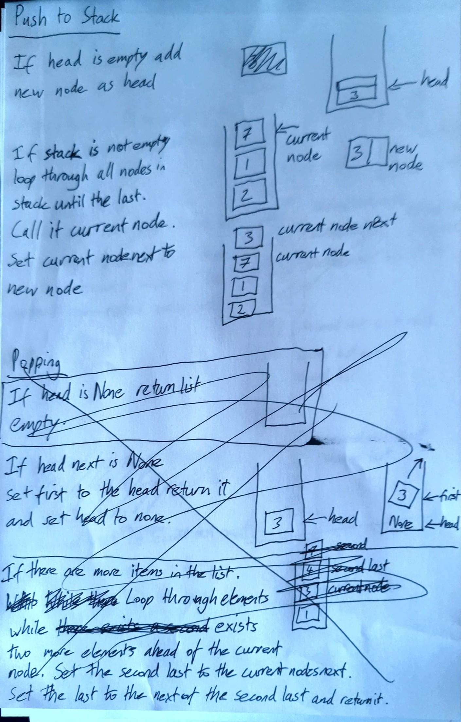

Slide 5
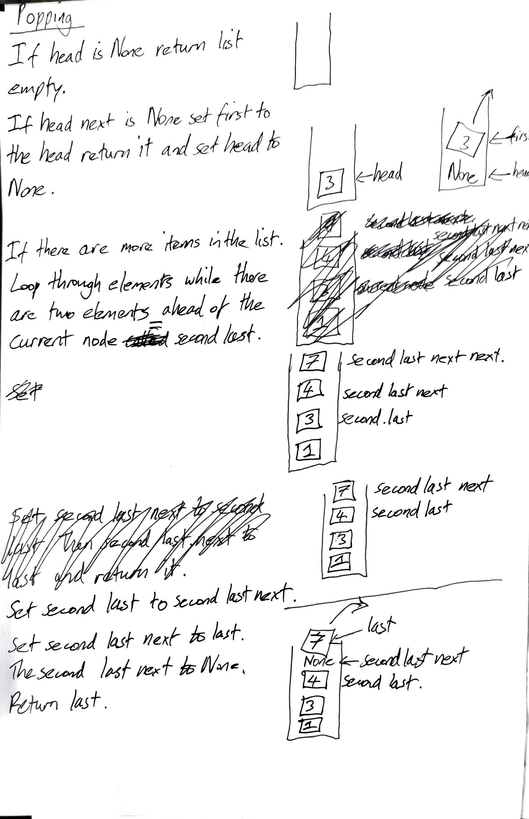

Slide 6
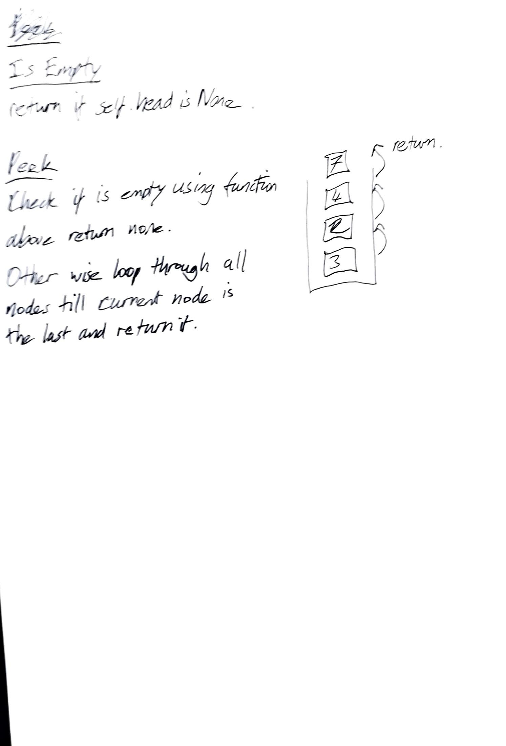

Slide 7
Queues

Slide 8
